Slide 1
Security Awareness Training
wizer-training.com

Slide 2
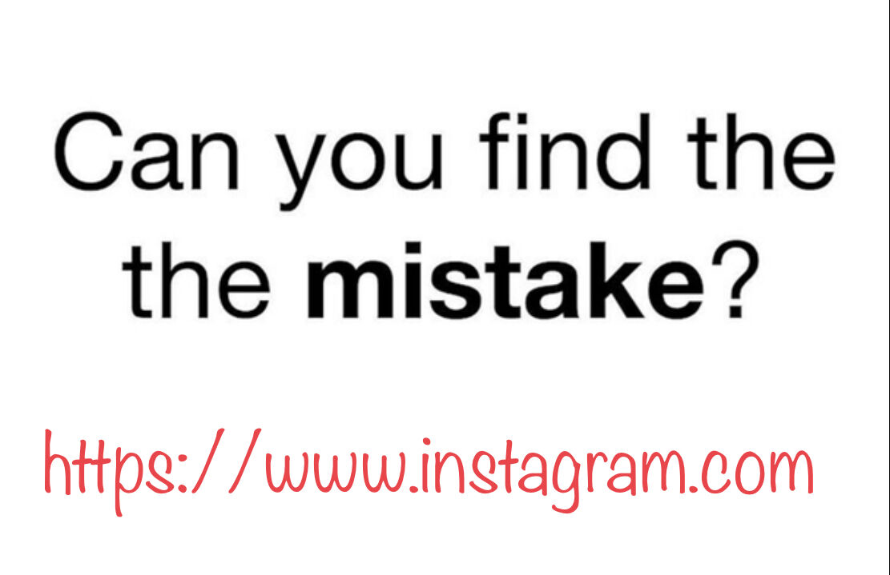
Notes:
https://www.linkedin.com/posts/gabrielfriedlander_lets-play-if-you-figured-it-out-comment-activity-6853476793853239296-j2aI

Slide 3
Social Engineering
Is about
Distraction
and
Misdirection

Slide 4
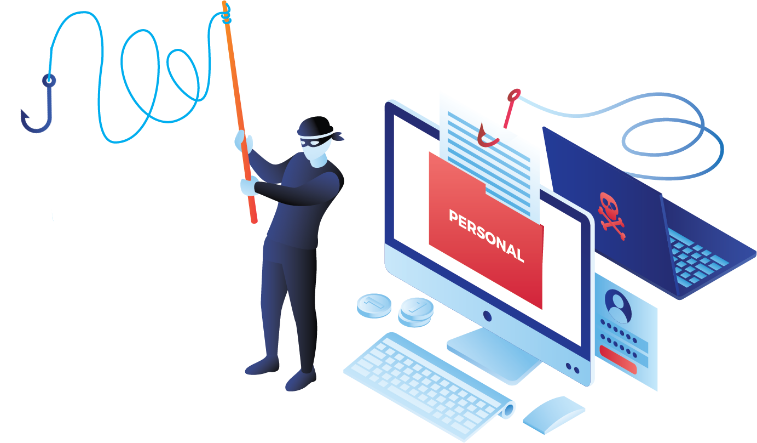
Phishing
When Scammers fool you to think they are someone you trust in order to make you do something.

Slide 5
7 Types of Phishing Scams You Should Know About

Slide 6
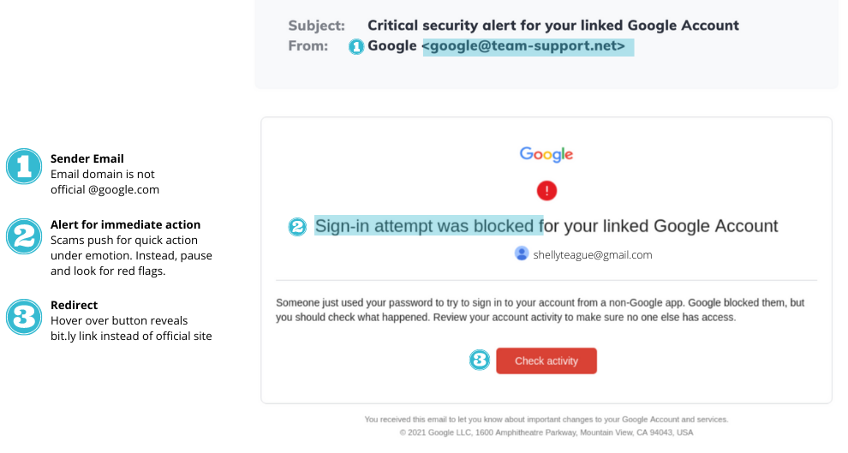
Email Phishing Scams
It may look like an email from your bank, Paypal, Google, Amazon, or even your CEO.

Slide 7
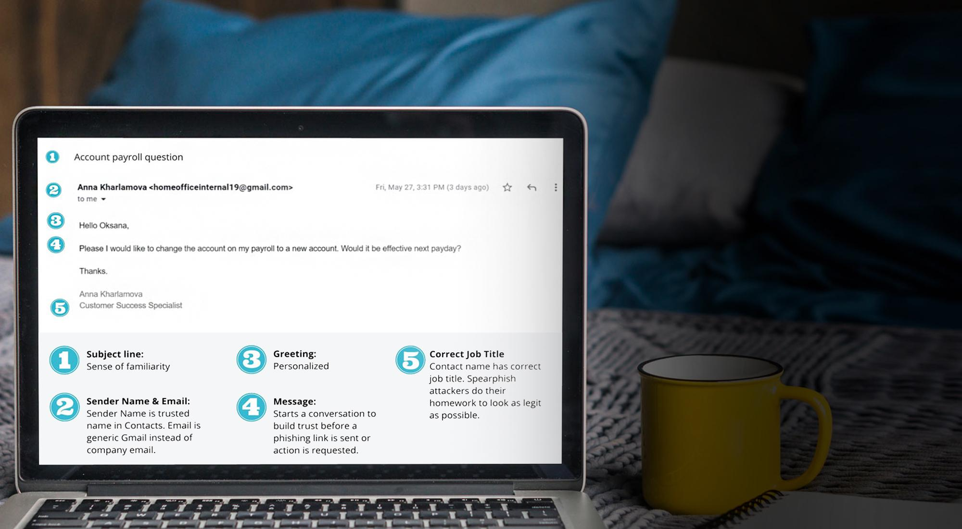
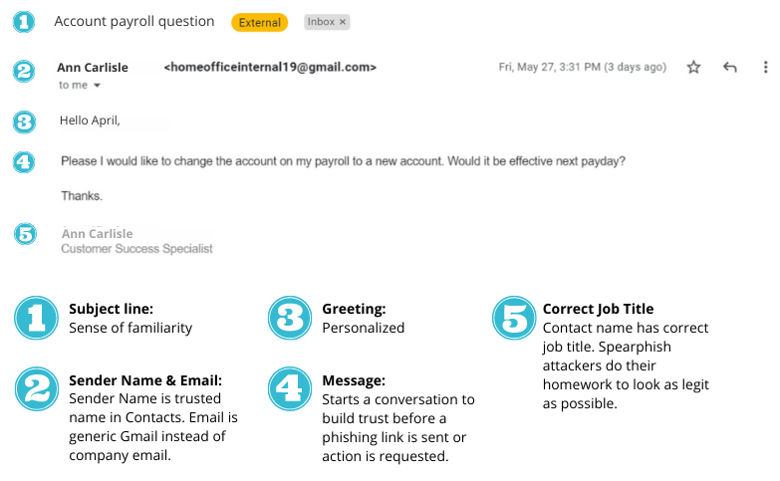
Spear Phishing Scams
This is when they target you specifically. They have researched you, they know your family members, where you work, and who is your boss. The chances of fooling you are higher.

Slide 8
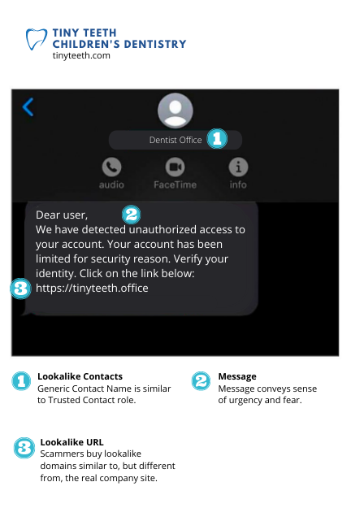
Smishing
Scams
These are text message phishing scams. Criminals know people respond to text and instant messages faster than email.

Slide 9
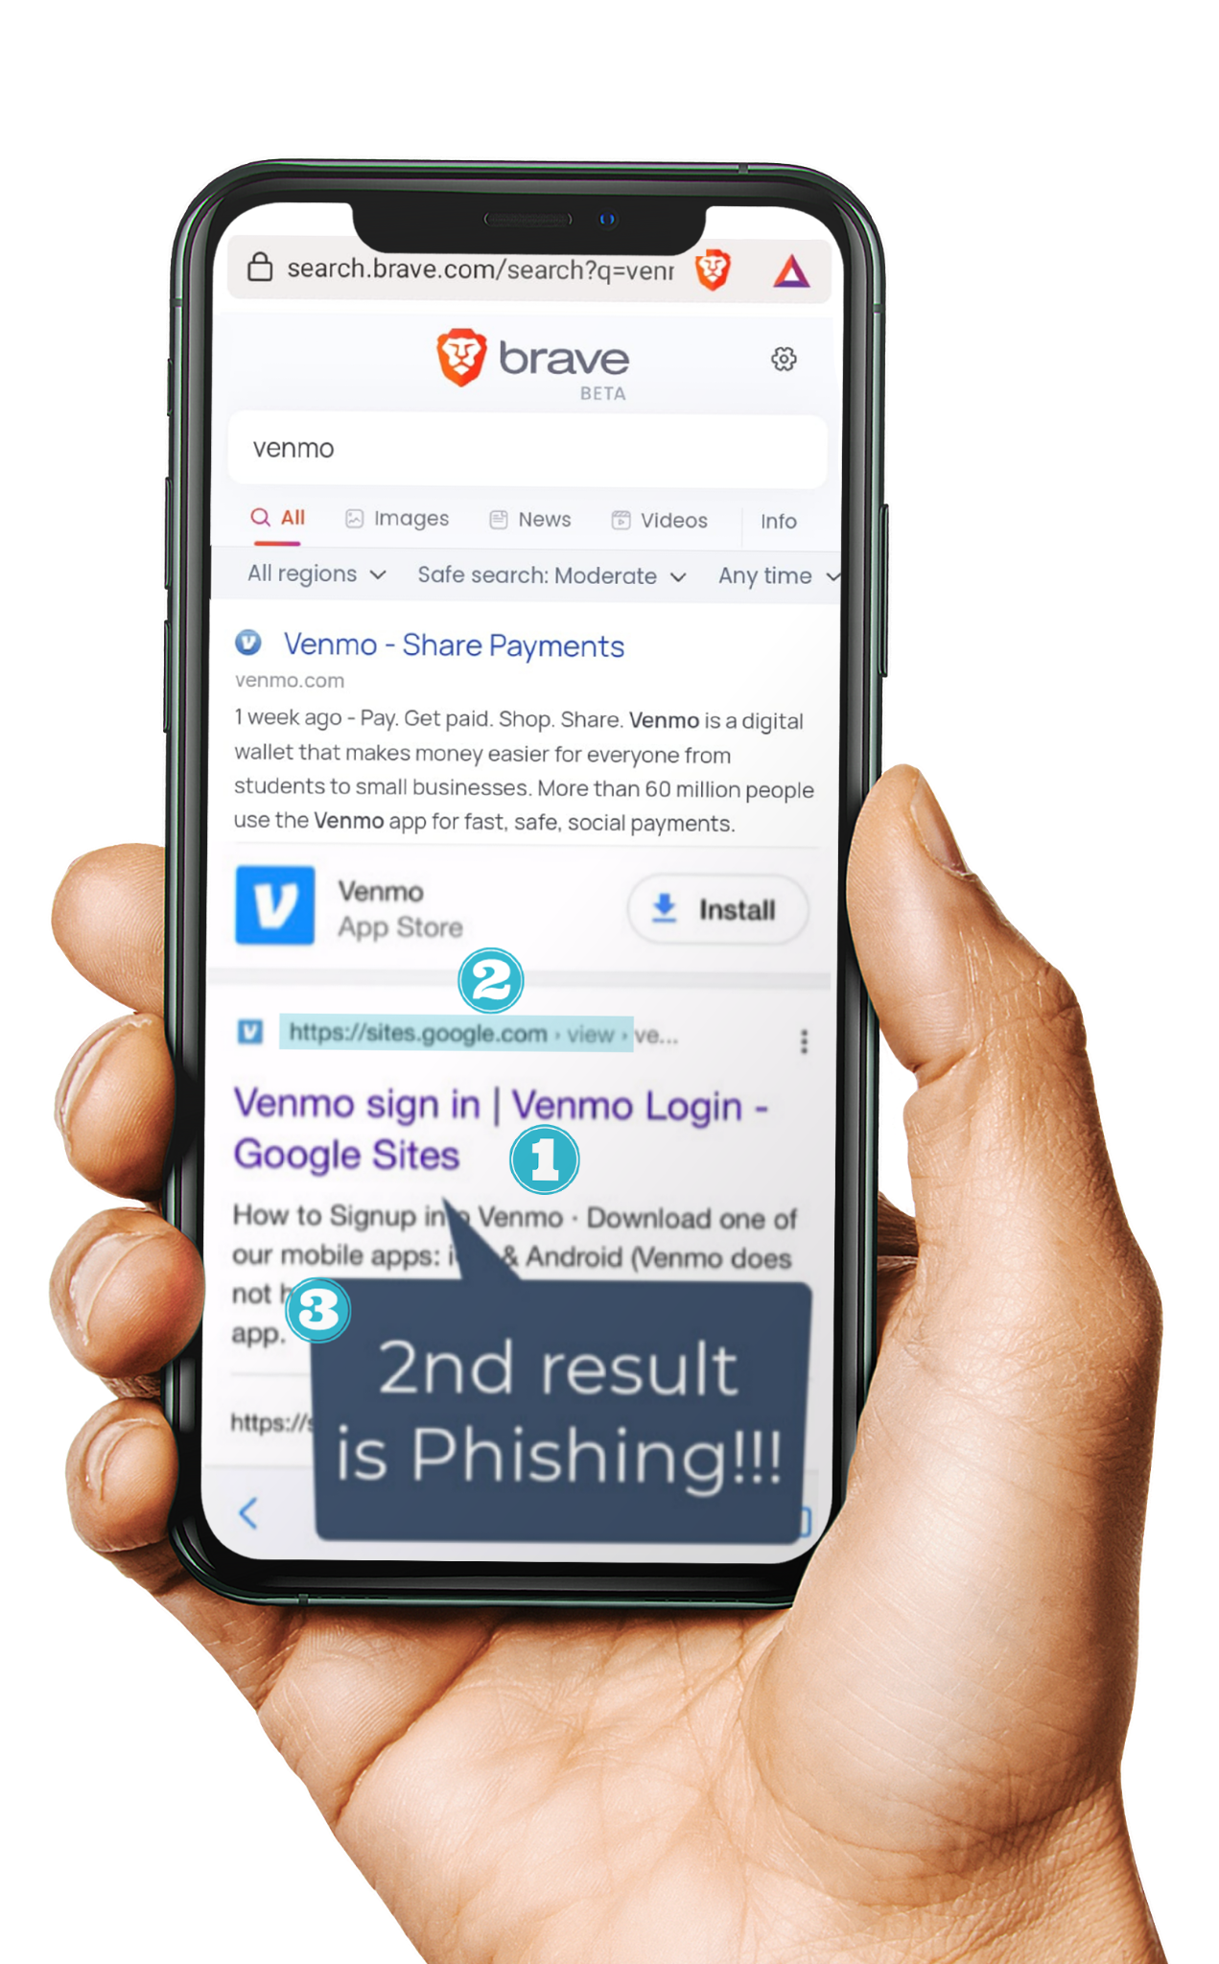
Google
Search
Scams
Search Result Shows Brand
Title displays correct brand name
You may be surprised, but some of the top search results in Google are phishing links.
Scammers also invest in search engine optimization and work hard to rank their scam sites in the top search results.
URL Mismatch
Title says Venmo but URL is a generic sites.google.com
2nd Result for Organic Search
Even top search results can be manipulated for fake sites

Slide 10
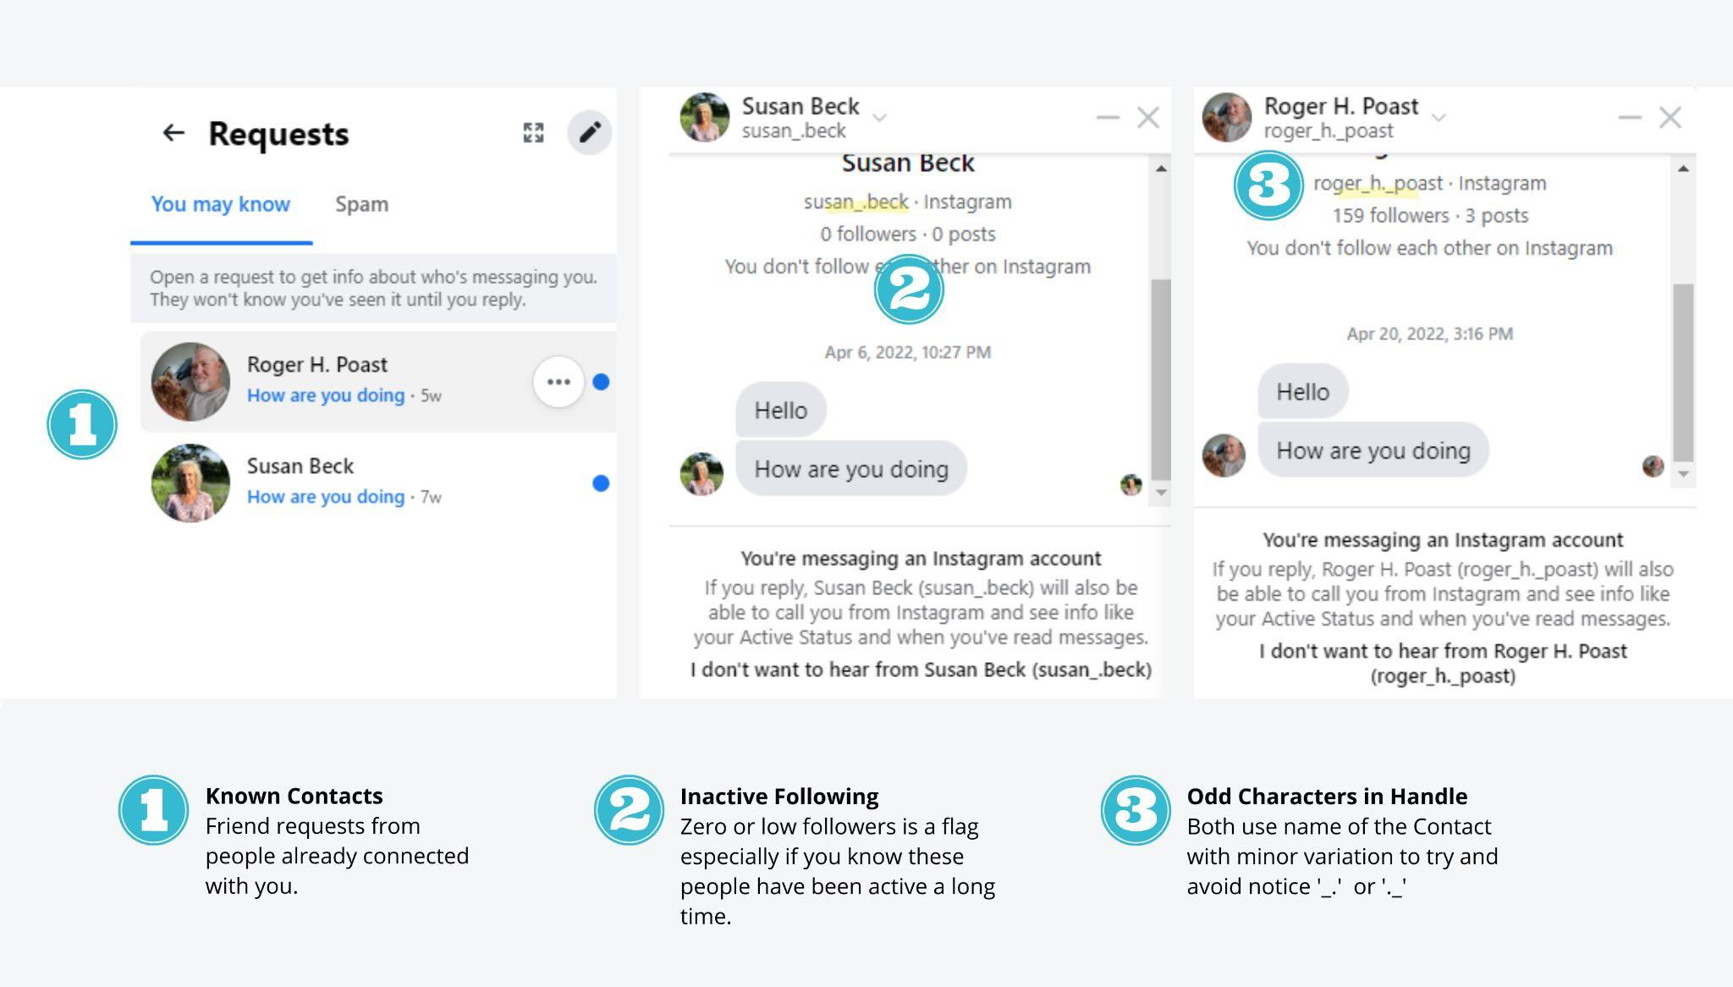
Social Media Scams
Social media is full
of fake accounts.
It could also be a fake account with the same name and photo as one of your real friends that will later try to scam you.

Slide 11
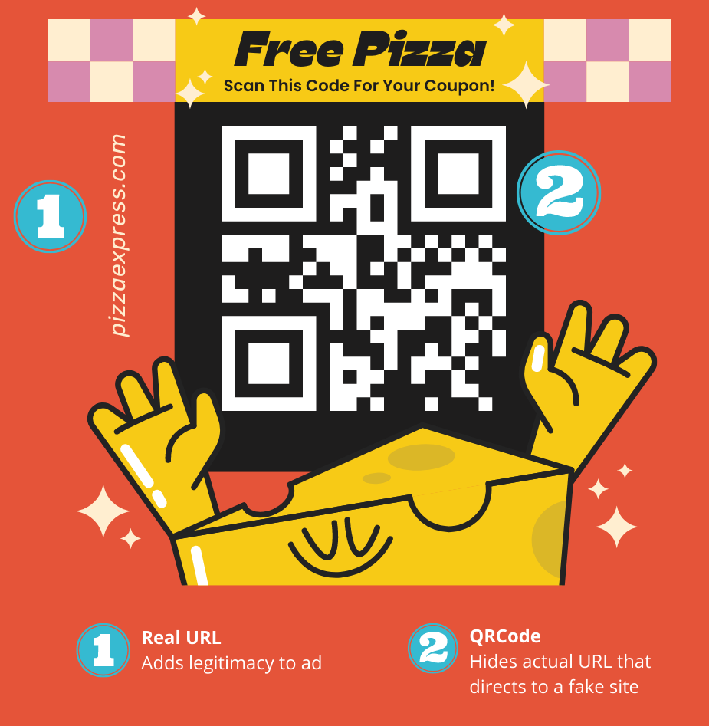
QR Code Scams
Who thought a QR code could be dangerous?
They are everywhere, especially in restaurants. Criminals can place their own sticker over the legitimate one. So that when you scan it, you will be redirected to a fake site.

Slide 12
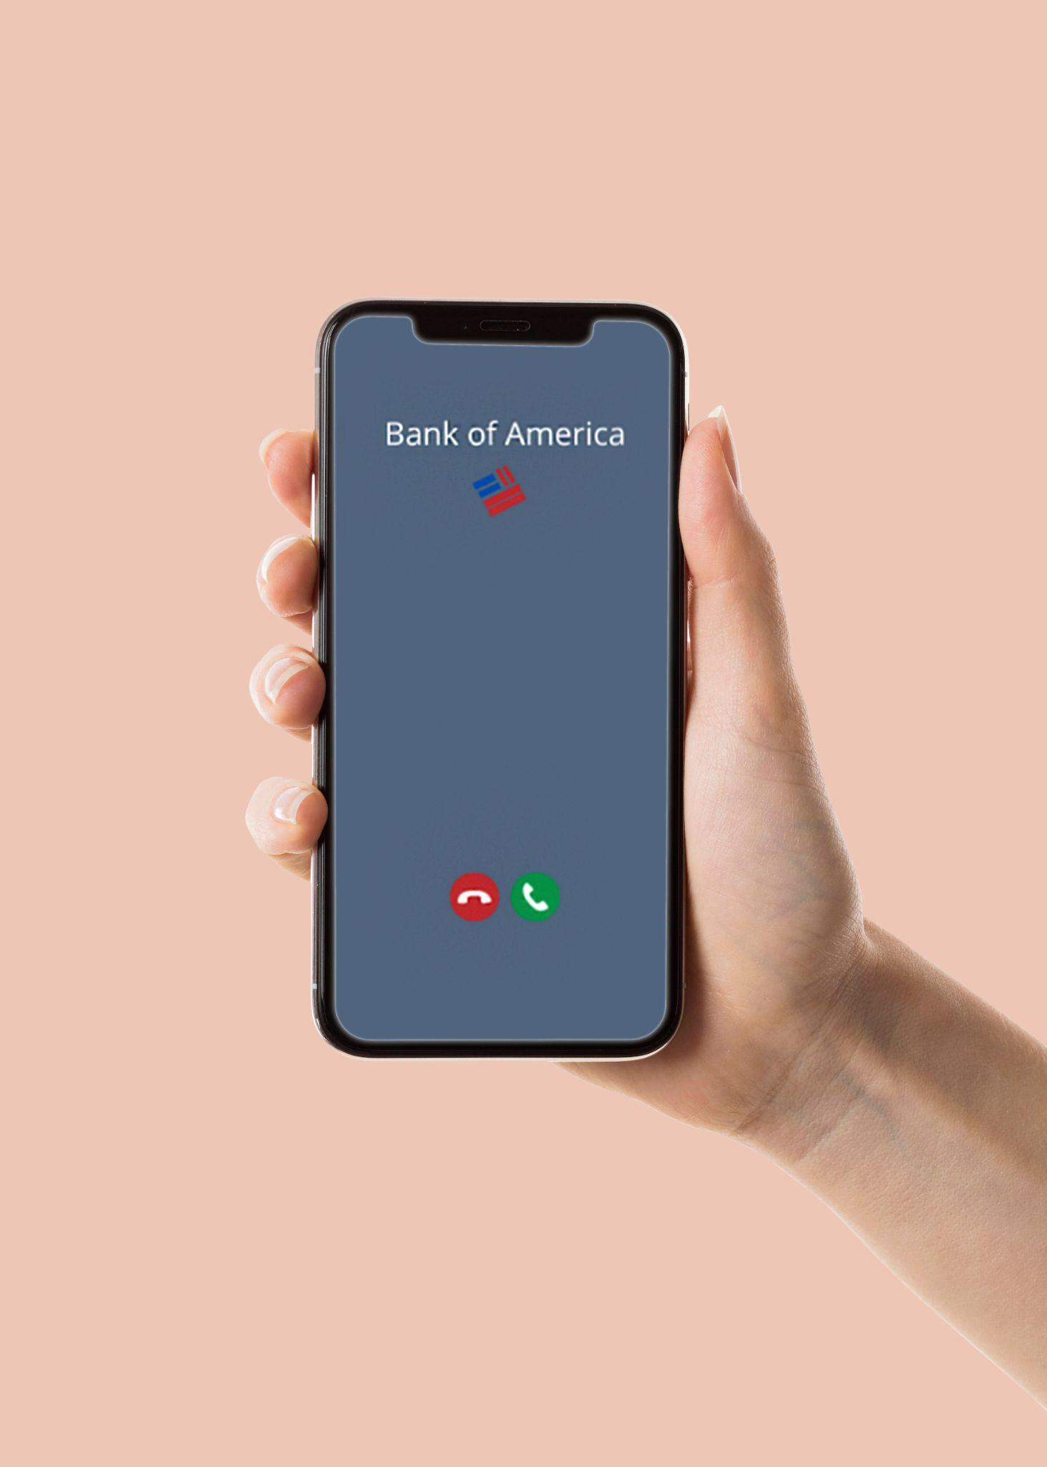
Vishing Scams
Vishing (voice phishing) is a type of phishing attack made over the telephone. Scammers can spoof a phone number that looks identical to a known number, like your bank.
Trusted Brands
Numbers for personal and commercial contacts can be spoofed.

Slide 13
What Helps Protect You From Phishing Attacks?
If it’s urgent, don’t let the emotions cloud your judgment
Call and verify! - Verify that you are talking to the correct person
Check the address - Always check the email address and URL for spelling mistakes
Enable Multi-Factor Authentication
Look at the style of the message
Ask questions

Slide 14
How long will it take
to crack your password
7 characters | 1 minute
8 characters | 1 hour
9 characters | 3-4 days
10 characters | 7 months
11 characters | 40 year
12 characters | 2000 years
Passwords include - Lowercase, Uppercase and Numbers

Slide 15
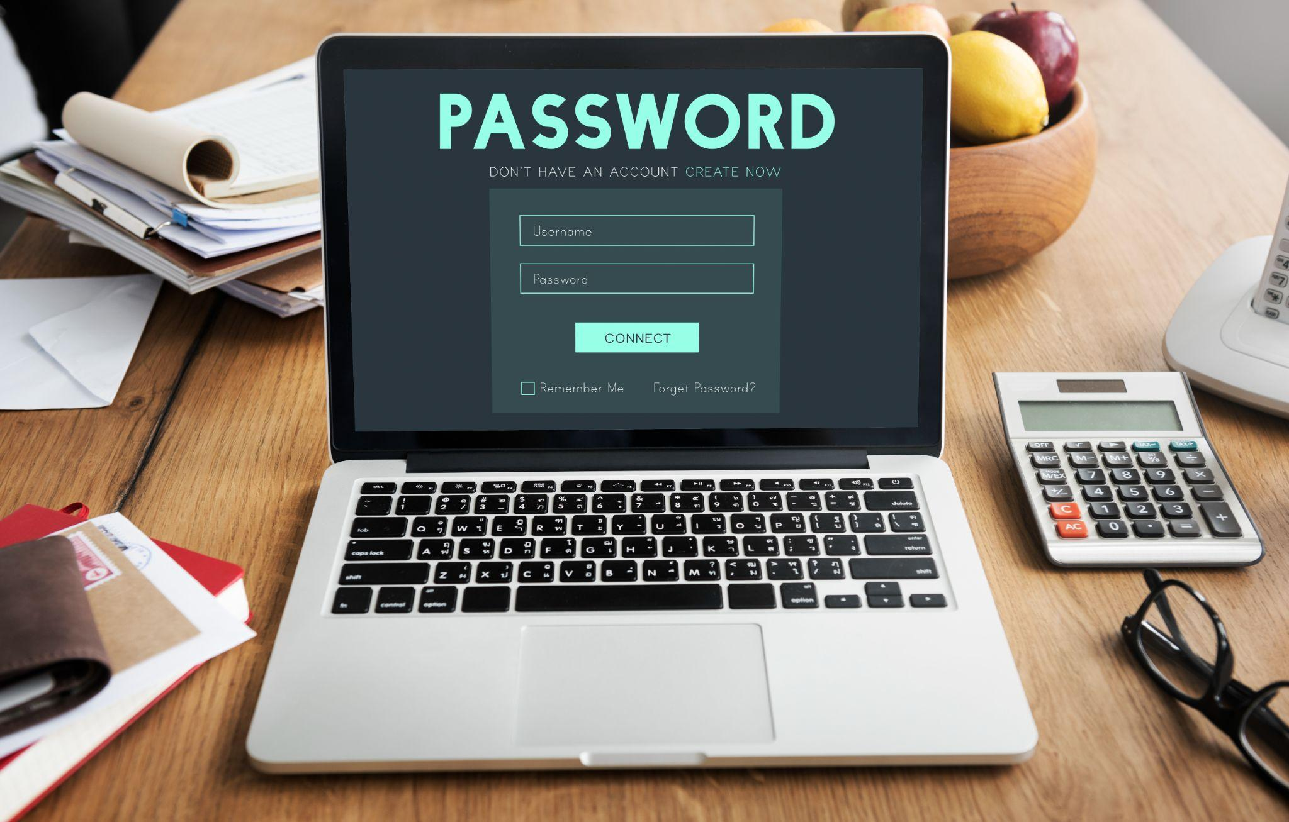
How to create a strong Password:
Passwords need to be long!
Use a phrase (NO personal info like your name or B-Day)
Don’t reuse passwords!

Slide 16
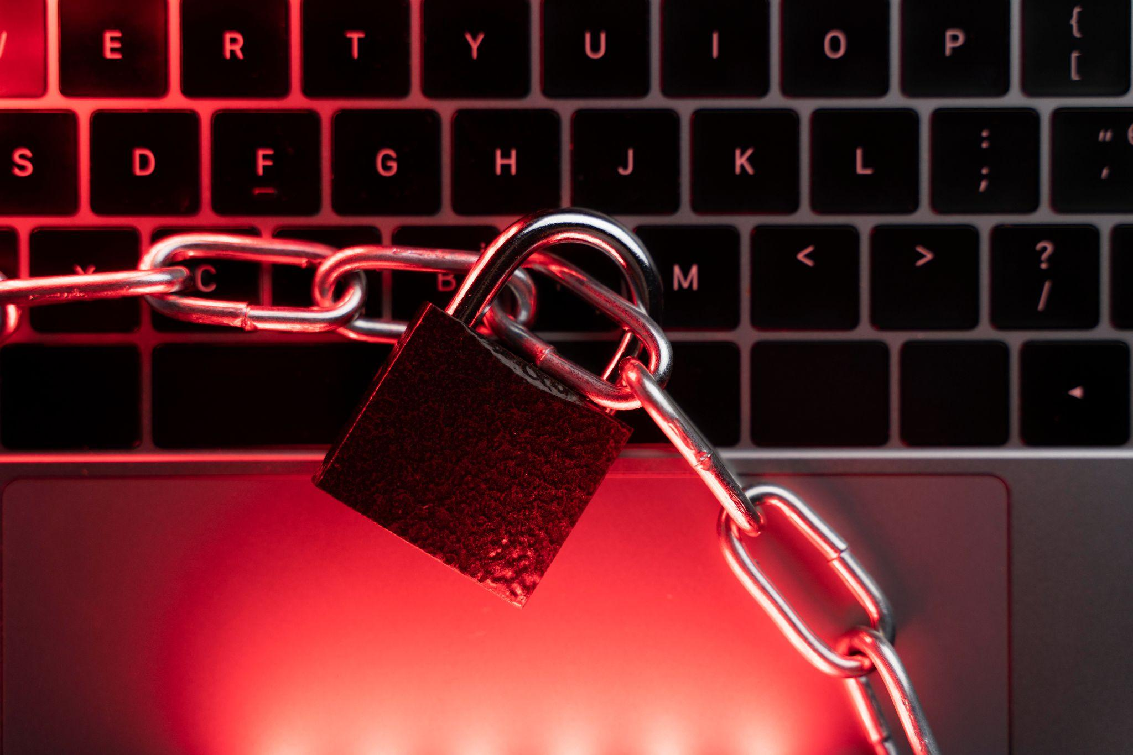
HOWEVER….
11 BILLION Accounts were stolen from
hacked sites and apps.
So even if you have a STRONG PASSWORD, it may still not be enough.
You can check if yours was leaked at haveibeenpwned.com

Slide 17
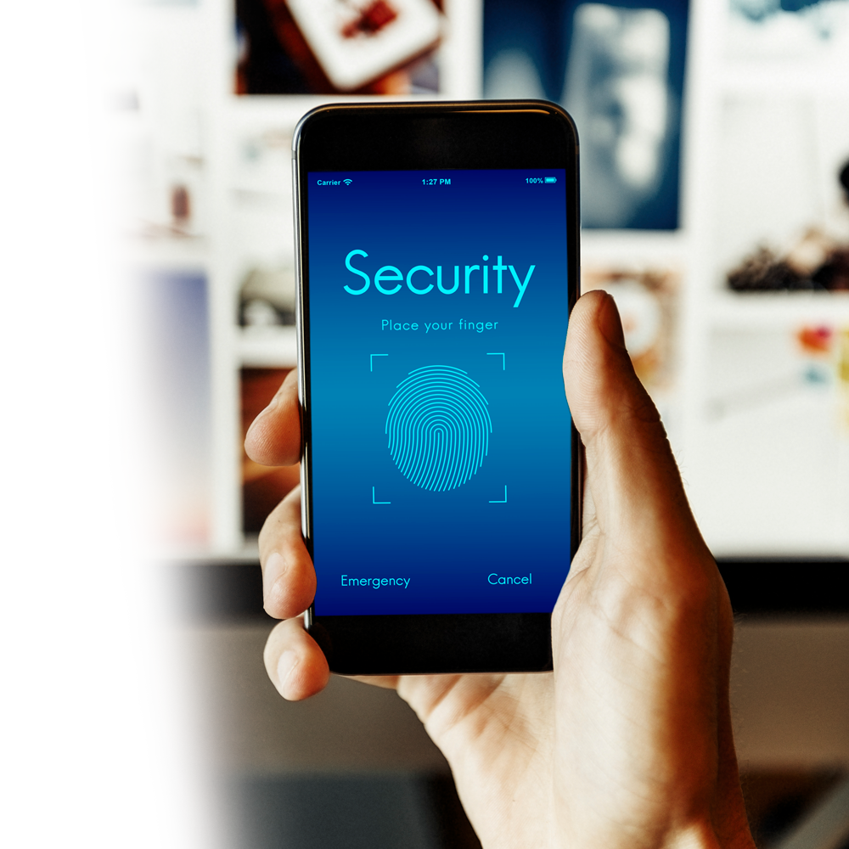
And That is Why…
… You should enable Multi-Factor Authentication
This will help to protect
your account if your
password was stolen or
leaked in a data breach.

Slide 18
What type of Multi-Factor Authentication to use?
Most common is text based (SMS),
but it’s the least secure
It’s better to use authenticator apps
like Google or Microsoft Authenticator
Or even better yet, a physical USB key

Slide 19
How to avoid getting hacked
on public WiFi:
If you have the option to use your mobile data plan,
that’s better than public WiFi
Criminals often setup hotspots with fake Wifi Names, so ask the Barista or Receptionist for the Official WiFi Name
Enable the Firewall on your device and use a VPN (Try to avoid Free VPN’s - some are owned by criminals)

Slide 20
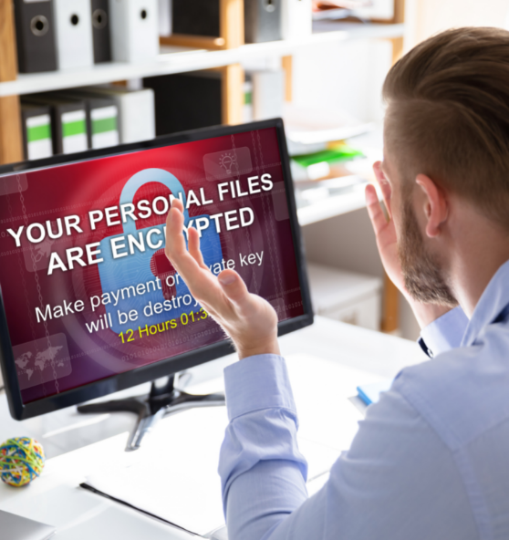
Ransomware
When criminals hack your computer or network, lock you out, and demand a ransom to let you back in.

Slide 21
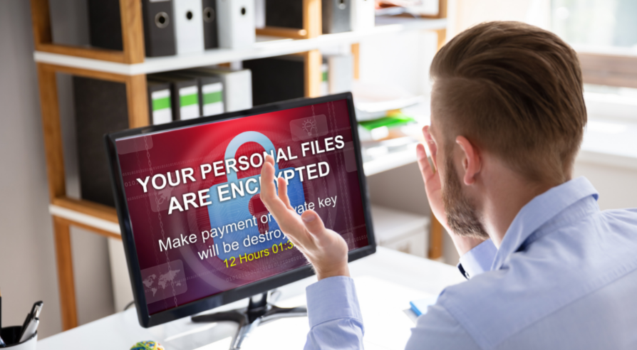
How to Avoid Ransomware
Don’t download files from random websites
Beware of phishing emails with attachments
(See phishing section)
Don’t use your company email or password for personal stuff
Don’t store password in text files or spreadsheets

Slide 22
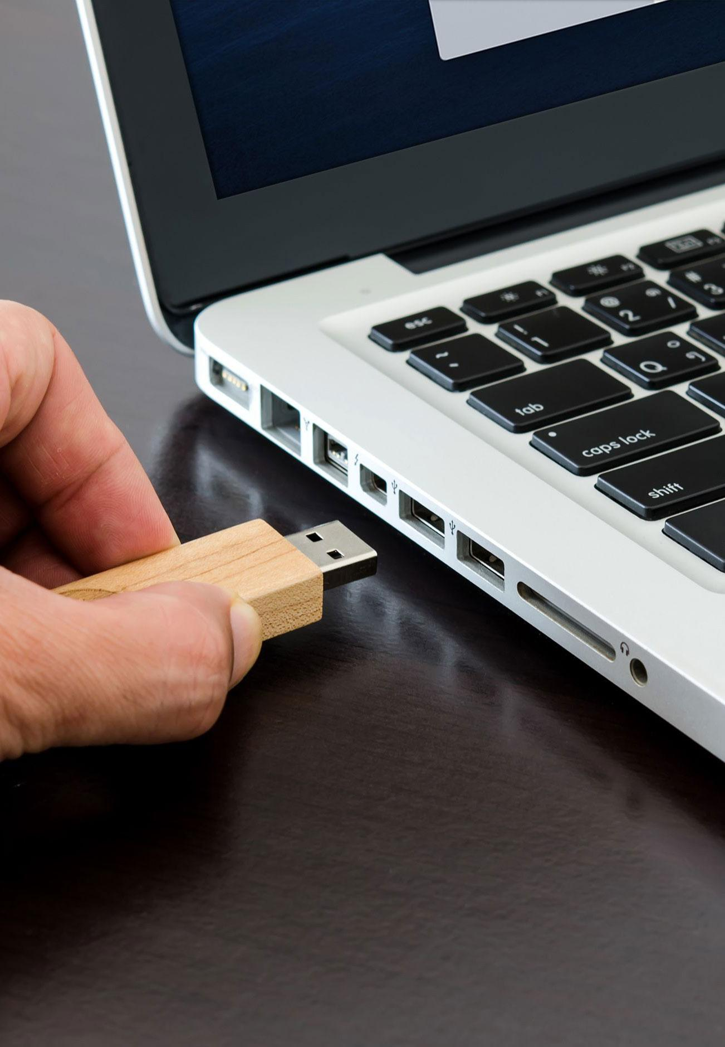
How to use USB Safely
Avoid public charging stations.
They may be compromised.
Don’t plug any USB that isn’t yours into your device
Encrypt the data on the USB device in case you lose it or it gets stolen.

Slide 23
What is Wire Fraud?
It’s when you’re tricked into wiring money to a fraudulent bank account. For example:
An urgent request to wire money from a criminal who impersonates your CEO through hacking your CEO’s email account.
They hacked one of your vendors and sent you an invoice with fake bank information.
If you’re tricked into wiring money to a fraudulent bank account, the bank may not be there to help you. After all, it’s you who transferred the money, not the criminal.

Slide 24
How to Avoid Wire Fraud:
Call and verify any money Request
Call a known number that you used before or from the vendor management system
Verify that the bank info match the one on file
Call and verify any request to change info on file, like phone number, address or bank info

Slide 25
Whew!
You made it.
Get more tips to #stayWizer online at
wizer-training.com

